Slide 1
Subroutine in 8085 Microprocessor

Slide 2
Subroutines
A subroutine is a group of instructions that will be used repeatedly in different locations of the program.
– Rather than repeat the same instructions several times, they can be grouped into a subroutine that is called from the different locations.

Slide 3
Subroutines
In Assembly language, a subroutine can exist anywhere in the code.
– However, it is customary to place subroutines separately from the main program.
It saves the code space.

Slide 4
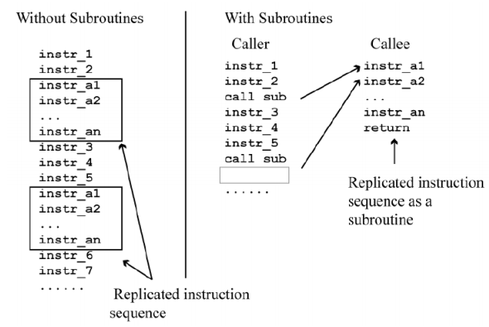

Slide 5
Subroutines
The 8085 has two instructions for dealing with subroutines.
– The CALL instruction is used to redirect program execution to the subroutine.
– The RET instruction is used to return the execution to the calling routine.

Slide 6
CALL Instruction
The call instructions allow calling the subroutine program.
The address of the subroutine program is specified with the CALL instruction.
The CALL instructions are also of two types. 1. Unconditional Call Instructions 2. Conditional Call Instructions

Slide 7
The Unconditional CALL Instruction
CALL address (Calls the addressed subroutine program)
CALL 4000H (3 byte instruction)
[SP −1] ← [PCH ] [SP − 2] ← [PCL] and [PC] ← address

Slide 8
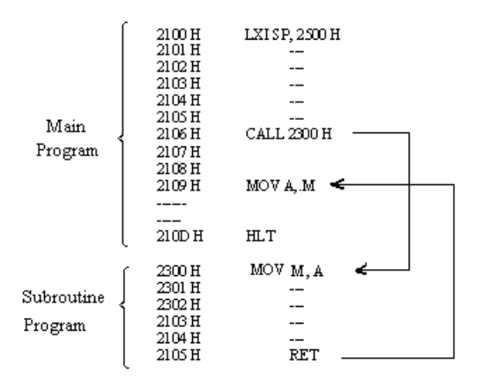

Slide 9
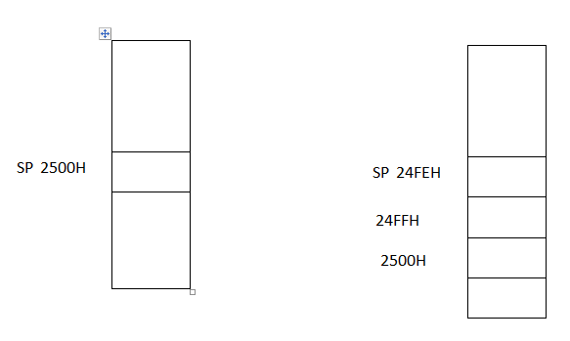

Slide 10
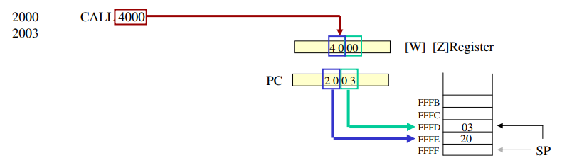
The CALL Instruction

Slide 11
The CALL Instruction
MP Reads the subroutine address from the next two memory location and stores the higher order 8bit of the address in the W register and stores the lower order 8bit of the address in the Z register
Push the address of the instruction immediately following the CALL onto the stack [Return address]
Loads the program counter with the 16-bit address supplied with the CALL instruction from WZ register.

Slide 12
Conditional Call Instructions
Similar to conditional jump instructions
CNZ address (Call if not zero)
This instruction will call the subroutine program specified by the address provided the zero flag is reset.
[SP −1] ← [PCH ] [SP − 2] ← [PCL] and [PC] ← address

Slide 13
The RET Instruction
RET (1 byte instruction)
– Retrieve the return address from the top of the stack
– Load the program counter with the return address.

Slide 14
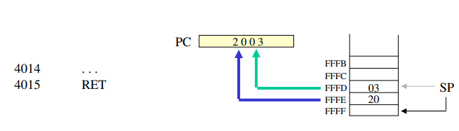

Slide 15
The return instructions may also be conditional.
The following are the conditional return instructions:
RNZ Return if no zero RZ Return if zero RNC Return if no carry RC Return if carry RM Return if minus RP Return if positive RPO Return parity is odd RPE Return parity is even

Slide 16
RNC if CY = 0 , then [PCL] ← [SP] [PCH ] ← [SP + 1]

Slide 17
A Proper Subroutine
A proper subroutine:
Is only entered with a CALL and exited with an RTE
Has a single entry point
Do not use a CALL statement to jump into different points of the same subroutine.
Has a single exit point
There should be one return statement from any subroutine.

Slide 18
Parameters Passing Techniques
There are four ways to pass parameters to and from the subroutine:
Using registers
Using general memory
Using Pointers
Using Stack

Slide 19
Passing Parameters using Registers
The data to be passed is stored in the registers
These registers are accessed in the subroutine to process the data.
Useful where we have to pass few parameters to and from subroutine

Slide 20
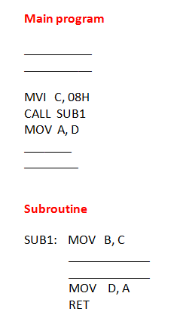
Example

Slide 21
Example of Passing Parameters using Registers
Write a program to exchange the higher and lower nibble of ten 8bit numbers stored from location 2200H. Use subroutine technique.

Slide 22
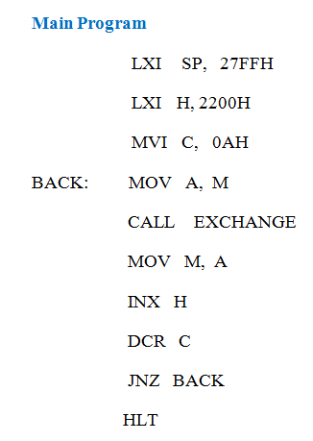
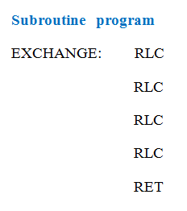

Slide 23
Passing Parameters using Memory
Useful incase of passing large number of parameters to subroutine.
The main program loads the predefined memory locations with values before calling the subroutine

Slide 24
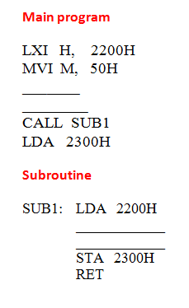
Example

Slide 25
Example of Passing Parameters using memory
Write a program to exchange the higher and lower nibble of ten 8bit numbers stored from location 2200H. Use subroutine technique.

Slide 26
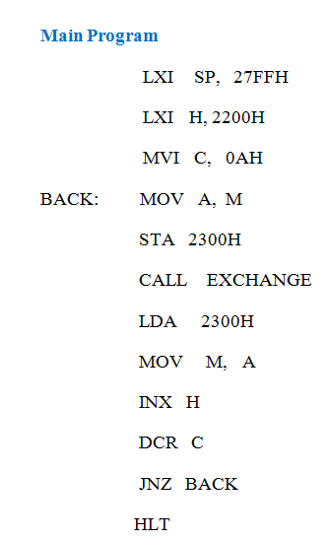
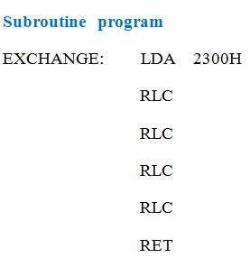
Example of Passing Parameters using memory

Slide 27
Passing Parameters using Pointers
The main program stores the parameters to be passed in the memory.
Then it loads register pair or pre-defined memory locations with starting address of the parameter list.
The subroutine obtains parameter list by accessing it in sequence from the given address

Slide 28
Example of Passing Parameters using Pointer
Write a program to exchange the higher and lower nibble of ten 8bit numbers stored from location 2200H. Use subroutine technique.

Slide 29
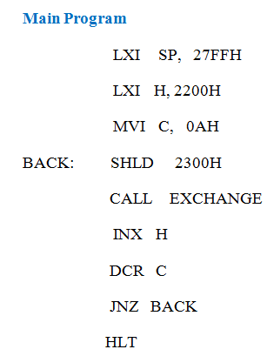
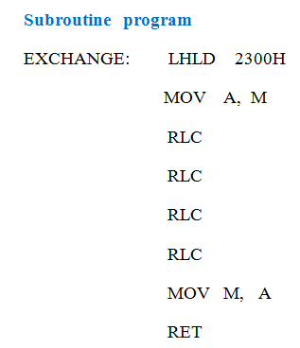

Slide 30
Passing Parameters using Stack
The parameters are pushed on the stack before the call of subroutine in the main program
It is important to keep track of what is pushed on the stack and where the stack pointer points all the time in the program.

Slide 31
Example of Passing Parameters using Stack
Write a program to exchange the higher and lower nibble of ten 8bit numbers stored from location 2200H. Use subroutine technique.

Slide 32
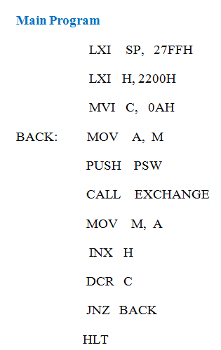
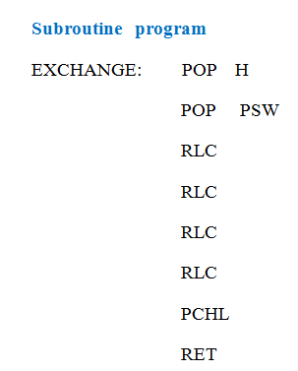
Example of Passing Parameters using Stack

